Slide 1
By- Akshar Patel- 19881A05J4
Ram Tej- 19881A05L4
Bhanu Prakash- 19881A05M6
Charan Teja- 19881A05N7
Vishnu Vardhan- 19881A05P2
EDT PROJECT
AgriCultureZone - web application

Slide 2
ABSTRACT
India is an agricultural country. In India, most of the population is dependent on the farming for survival. The development of agriculture has much to do with the economic welfare of our country. Many farmers are not aware about the outside world and the technical advancement about the farming. Most of the farmers doesn't have any idea about the rates of the crops and they sell their products at any cost. In today's world, Farmer does not get the Right information or news about the nearest market rates present in their region. As most of the Farmers are not aware of existing technology, they don't get any current news about the farming schemes. At the end, they have to sell their products at very low cost.
Smart phone makes all our tasks fast, efficient & accurate. we are creating a platform for farmers who are using smartphones where they can get the real time updates about the vegetables, fruit rates of every market in India and they will be able to sell their products at the proper rates.

Slide 3
Our Web application gives feature where all the farming related notices from the government will be added and farmers will get a proper information about different schemes. Depending on the certain market conditions of current week and previous one or two week, our system will predict future rates. So, it would be beneficial for farmers to sell their commodities at a particular time in a market. Also, feature of weather information will help farmers to plan for next 2-3 days.
Many times, A farmer is confused to take decisions regarding selection of fertilizer, pesticide and time to do particular farming actions. To avoid this problem our Web application is very useful. Fertilizer schedule of every form of crop can get registered. Based on sowing date of crop, farmer will get reminders about application of fertilizer, herbicide as per schedule, pesticide for diseases and weather alerts if particular crop exceeds its favorable temperature range. Crop suggestion are given based on supported Soil kind, geographical location.

Slide 4
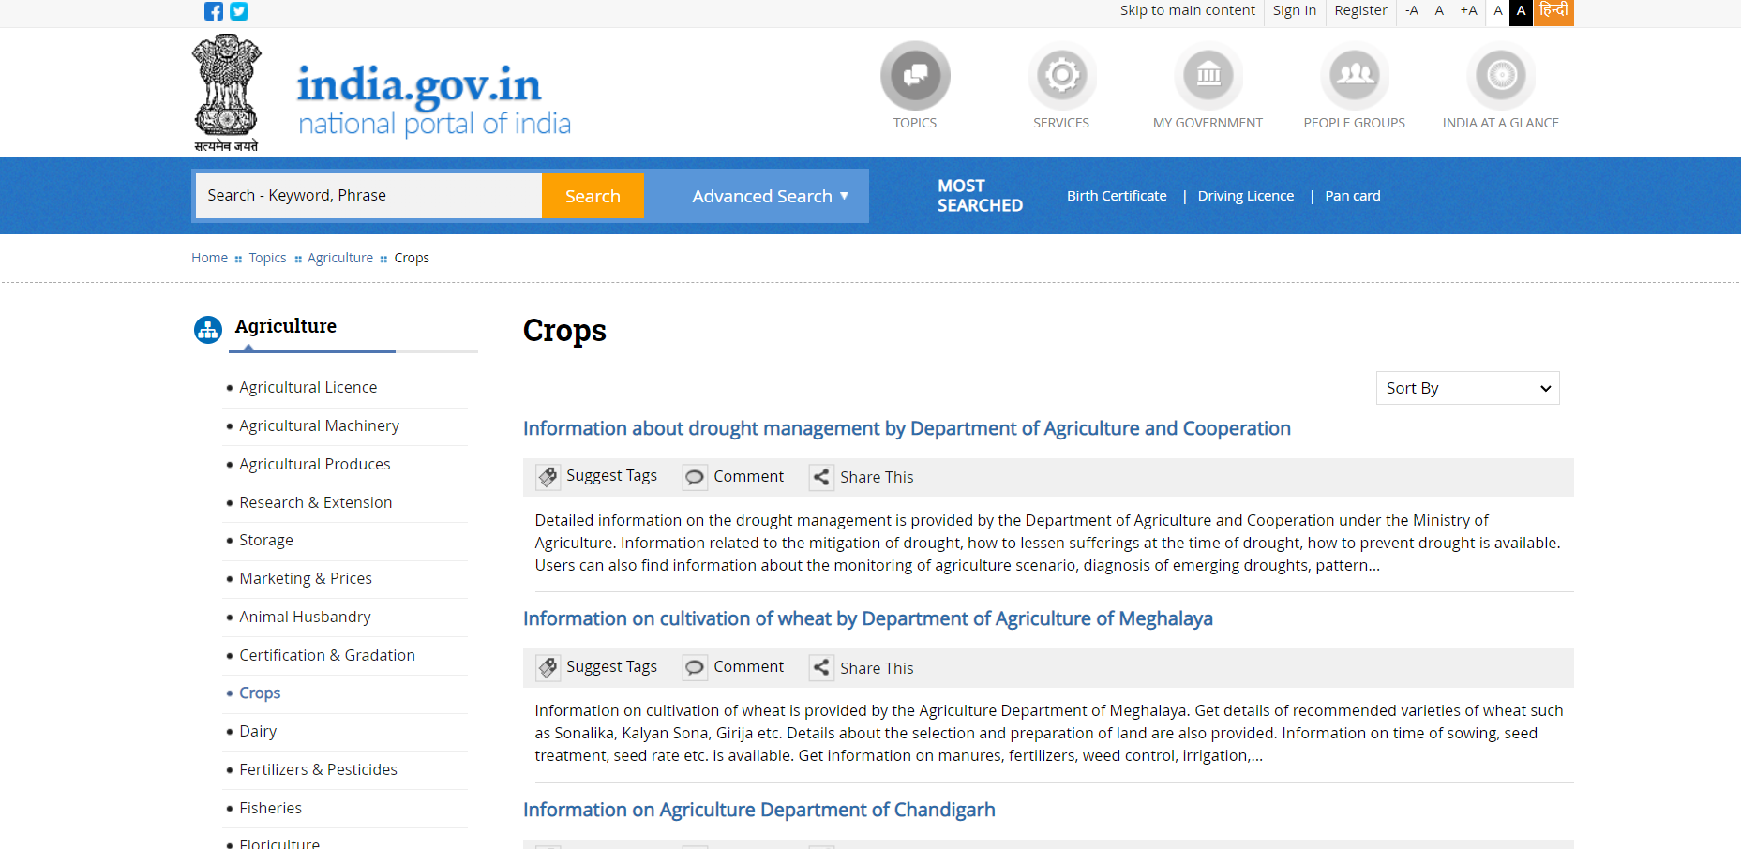
EXISTING PROJECT
National Portal of India-www.india.gov.in

Slide 5
DISADVANTAGES
No proper interface and arrangement of data.
No sufficient Information on crop-cultivation and variety of crops.
It does not contain Market rate feature required to know the current rates for crops.
No detail requirements are specified for cultivation of crops.
No Calender and alerts to the user.

Slide 6
ADVANTAGES OF OUR PROJECT
Simple and easy to use interface.
Market Rates - It shows the price list of crops that are available in the market.The price of vegetable is periodically updated by the admin or head of local market members.
Government Schemes - Government of India will launch different Programs which are beneficial to Farmers. So, we provide detailed information of different programs.
Maintaining Calenders and Alerts - It also helps you maintain the schedule of farming and there would be less chance of missing or being late for a task on your farm.

Slide 7
Thank You!
Aug 3, 2020
7

